Slide 1
Rhetorical appeals

Slide 2
Developing Effective Arguments
So far we’ve covered:
Academic writing conventions
Research questions
Revision and summary
Academic Writing
Argumentation
Research Essay

Slide 3
Overview
What is a Rhetorical Appeal?
Kinds of Appeals
Logos
Pathos
Ethos
Kairos

Slide 4
What is Rhetoric?
The art of effective or persuasive speaking or writing.
At the time, persuasive speech was the dominant form of communication in early Greek society.
5 Canons: Invention, Arrangement, Style, Memory, and Delivery.

Slide 5




What does classical rhetoric have to do with the modern writing process?
Invention
Arrangement
Style
Memory
Delivery
Prewriting
Drafting
Revising
Editing/Proofreading

Slide 6
What is a Rhetorical Appeal
In Ars Rhetorica, Aristotle (a Greek philosopher, c. 384-322 BCE) outlines 3 basic strategies for persuading an audience:
Logos
Pathos
Ethos
A classical argument uses all 3 appeals.

Slide 7
Classical Arguments and Appeals
Introduction – use pathos and ethos to hook the audience
Body of Argument – use logos to refute arguments; use ethos to concede points; pathos features appears at beginning and end of each point.
Conclusion – use pathos to make a final call to action

Slide 8
When do we use rhetorical appeals?
ALL THE TIME! Including, but not limited to:
Advertisements
Political campaigns
Essays
TED Talks
Architecture and design

Slide 9
What makes an appeal successful?
Understands the target audience
Avoids logical fallacy (errors in reasoning that discredit the argument)

Slide 10

Logos
Appeals to an audiences’
sense of reason.
Academic and technical writing often uses logos to construct logical arguments.
Places you’ll find logos: statistics, objective facts, formal definitions, graphs/charts, syllogisms

Slide 11

How does this advert appeal to an audience’s sense of reason?

Slide 12
Logos
Advertising often attempts to appeal to logos, and so does the current anti-vax movement.
Usually, these appeals really rest on logical fallacies.

Slide 13

Straw Man
“People who get the vaccine hate freedom.”

Slide 14

Slippery Slope
“If we mandate the Covid vaccine, what’s to stop the country from becoming a totalitarian state?

Slide 15

Moral Equivalence
“The persecution I face for not being vaccinated is just like what the Jewish people faced during the Holocaust”

Slide 16

Pathos
Appeals to an audiences’
sense of emotion.
Pathetic appeals evoke strong clear emotions (happiness, anger, sadness) as well as more subtle feelings (warmth, well-being, belonging)
Places you’ll find pathos: advertisements, editorials, personal/reflective essays, anecdotal arguments

Slide 17

How does this advert appeal to an audience’s sense of emotion?

Slide 18

Ethos
Appeals to an audiences’
sense of authority and
credibility of the rhetor.
Trust in the person making the argument is key.
Because this was originally linked to rhetor’s moral character, it’s known as the ethical appeal.

Slide 19
Ethos
Can be situational:
The format of academic writing (citations, credentials, peer review) is designed to appeal to ethos
News broadcasts, with desks, authorial voices, graphics is also designed to appeal to ethos
Places you’ll find ethos: advertisements, spokespeople, politicians

Slide 20

How does this image appeal to an audience’s sense of credibility?

Slide 21


We tend to believe arguments made by people who have expertise in that field

Slide 22


We also tend to believe arguments from people regarded as trustworthy, attractive, or likeable.

Slide 23


Successful advertising creates positive impressions of a brand or product so that future advertising can rely more heavily on appeals to ethos

Slide 24
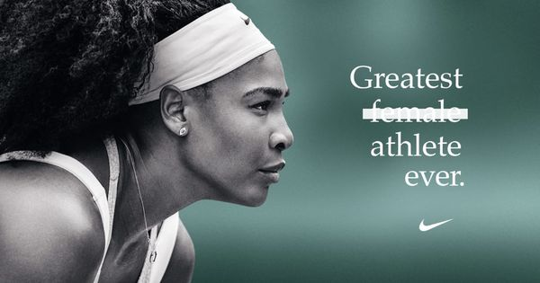
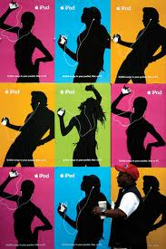
There are two basic types of appeals to ethos: extrinsic and intrinsic.
Extrinsic ethos relies on what the audience knows and understands about the speaker before they encounter his or her argument. (Note that this ad doesn’t work if you don’t know tennis player Serena Williams is the GOAT.)
Intrinsic ethos is the impression of the speaker created by the argument itself. Ads like this introduce the idea that the iPod is a fun product anyone could enjoy.

Slide 25
Do I have to pick just one?
Often we’ll use a combination of these three appeals in our academic writing.

Slide 26
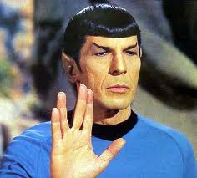
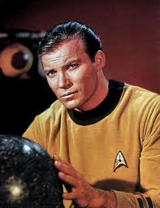
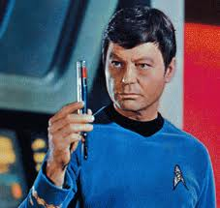
It might help you to remember the three appeals by associating them with familiar character types.
LOGOS?
How would these guys use different strategies to try to convince you to donate money to an organization like PETA or Save the Children?
PATHOS?
ETHOS?

Slide 27
Kairos
Appeal to audiences’ sense of timelessness.
It’s time to act!
Places you’ll find kairos: social movements, non-centralized campaigns leading to political/social/cultural change

Slide 28


Slide 29


Slide 30
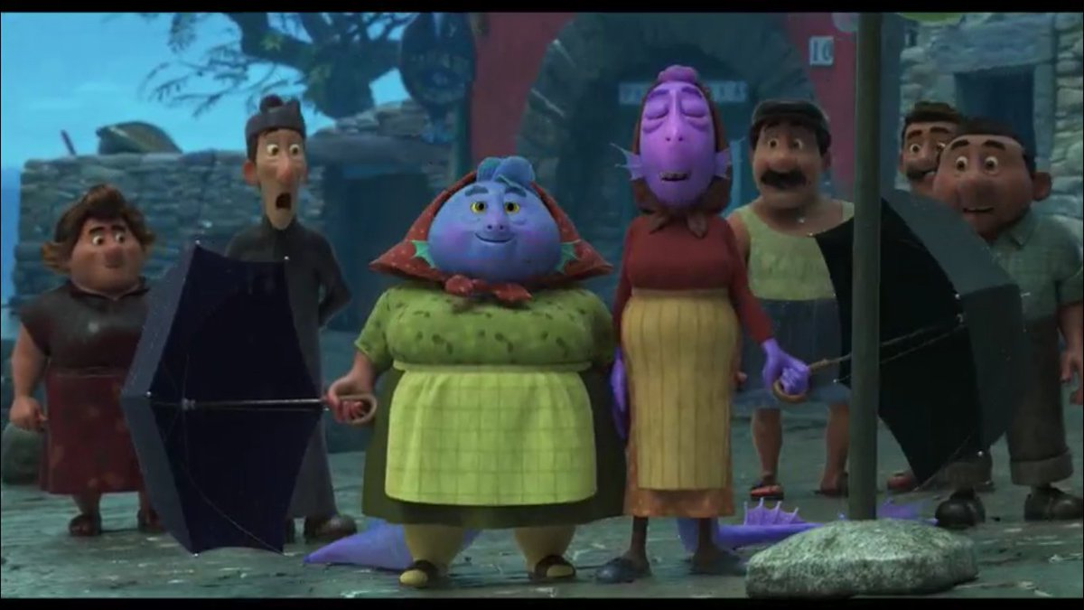
Kairos in Luca
At the end of the film, after Luca, Alberto, and Luca’s parents are revealed to be sea monsters, and are accepted by the sea monster-hating community, more hidden sea monsters decides it’s time to act!

Slide 31
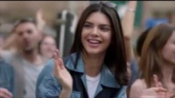
When Kairos goes wrong

Slide 32
Identify the Rhetorical Appeal
Each group will examine an image and determine
which rhetorical appeal(s) it uses
evidence showing which rhetorical appeal
Each group will then present their findings to the class (2-5 minutes per presentation).

Slide 33





1
3
2
5
4

Slide 34
Recap
Use rhetorical appeals to persuade your audience
4 main kinds
Ethos
Logos
Pathos
Kairos

Slide 35
Next steps – Rhetorical Analysis
We move from recognizing which appeal is employed to evaluating how effective the appeal is on its target audience.
Rhetorical Appeals
Rhetorical Analysis
Comparative Rhetorical Analysis

Slide 36
Further information
Why Write Ch. 3.5

